Slide 1
OBSERVABILITY
Open Source Observability for Cloud Native Applications
By Serdar Kalaycı
MAGANATHIN VEERARAGALOO
25TH DECEMBER 2021

Slide 2
CONTENT
WHAT IS OBSERVABILITY?
IMPLEMENTING OBSERVABILITY
CONCLUSION

Slide 3
WHAT IS OBSERVABILITY?

Slide 4
WHAT IS OBSERVABILITY?
Although it is often confused with monitoring, we need to say that the concept of observability, which was introduced with the adoption of Cloud Native and distributed applications, includes much more than observing software in a classical sense.
“Observability is a term borrowed from mechanical engineering /control theory. It means, paraphrasing: “can you understand what is happening inside the system—can you understand ANY internal state the system may get itself into, simply by asking questions from the outside?””
In software all of the monitoring, logging, metrics collection, tracing, visualization and alerting observability - observe the services if they fulfil all of these practices at the optimum level—But that isn’t the goal.
Rather, as Brian Knox, points out the goal is “to build a culture of engineering based on facts and feedback and then spread that culture within the broader organization.”

Slide 5
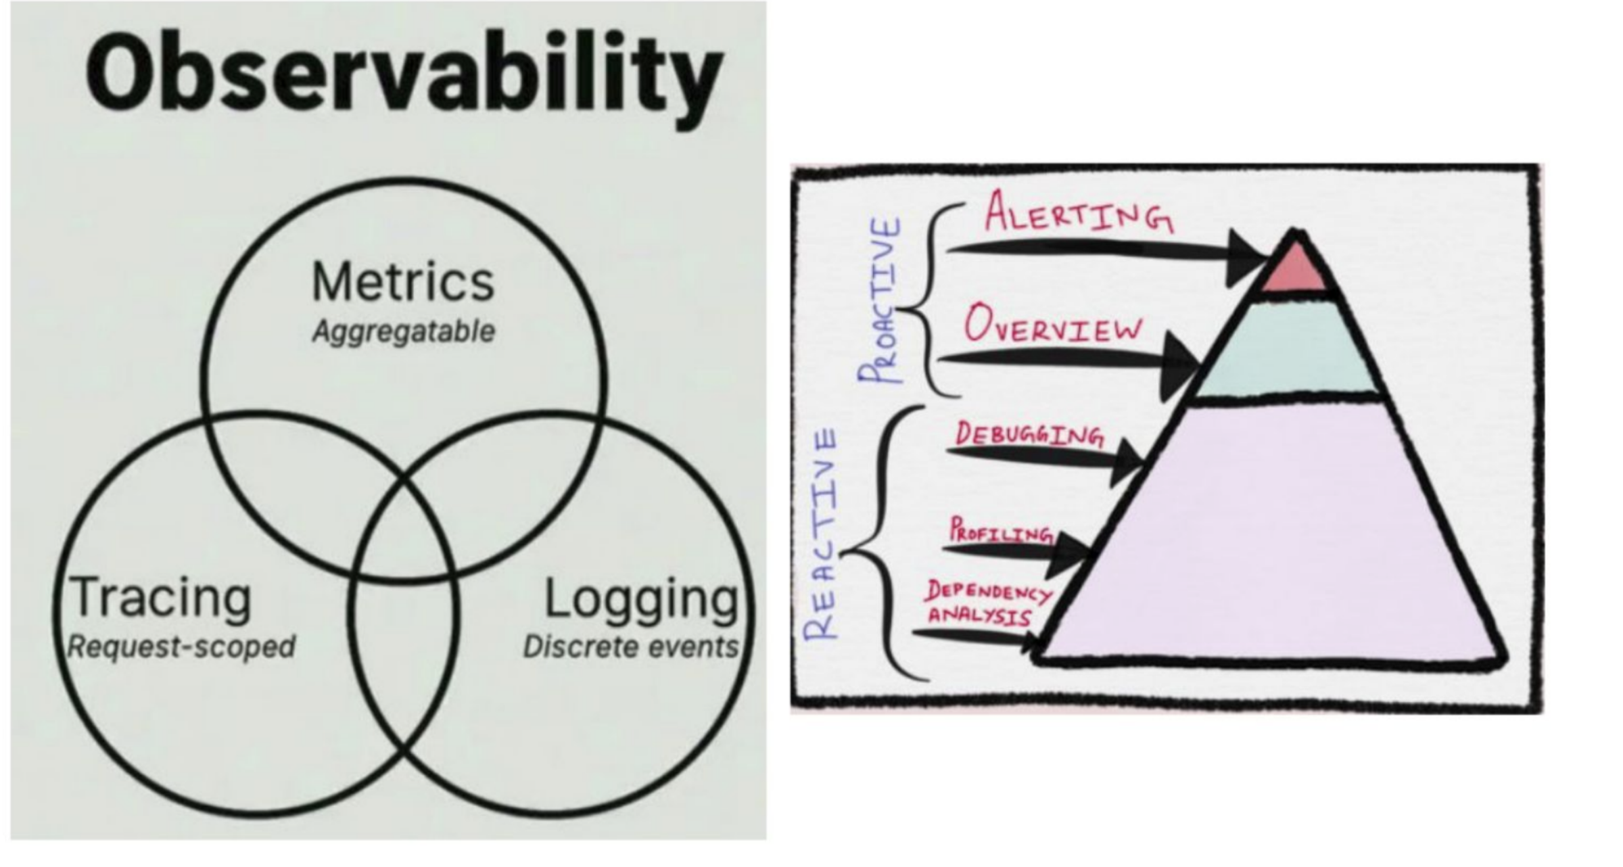
1. WHAT IS OBSERVABILITY?

Slide 6
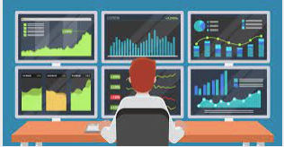
WHAT IS OBSERVABILITY?
Monitoring
Monitoring methods are always performed from the point of view of the user of the service, which is why they are called black-box checks.
This point of view is always useful because the fact that the service is up and running does not mean that it’s serving the user.
With monitoring tools, there is a chance to catch “predictable problems” with these methods.
Furthermore, the monitoring approach can inform if or when a problem occurred.
In other words, it is only possible to act reactively.
There is usually no way to warn proactively—before a problem occurs.
Finally, by monitoring, it will indicate there is a problem and what it is, but this approach will not hint at why it is so because it is done from the point of view of the end user.

Slide 7

WHAT IS OBSERVABILITY?
Logging
Logging, when used properly, can easily provide information about what happened when a problem occurs, and also why it happened.
However, just like the monitoring method, logging can only assist to identify predictable or foreseeable problems.
Indeed, in most cases, when an error occurs, it may be necessary to increase the logging level and wait until the same error occurs again to obtain tangible information about that error.
In other words, the logging method is a reactive method rather than a proactive one.

Slide 8
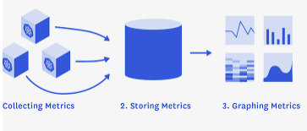
WHAT IS OBSERVABILITY?
Metrics Collection
Metrics, unlike logs, contain numeric values and allow access to numeric information to track specifics to the application, starting with basic hardware data, such as the amount of memory used by the application at any point during execution and the corresponding CPU consumption.
Since metric data is numerical, the cost of collection is lower than logging.
Therefore, metric data can be collected much more frequently than logs.
Changes in this data, stored at regular intervals, can assist to detect problems in the application before they are visible to users.
For example, it is not hard to predict that an application whose CPU usage increases by 10% every hour will become unresponsive after a few hours.
Even more accurate problem estimates can be made with machine learning models (ML) created by matching historical metrics data and errors.
For this reason, a widely used approach is to keep the collected metrics data in time-series databases and monitor them by graphing them on a time axis.

Slide 9
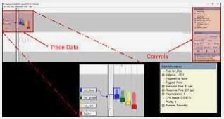
WHAT IS OBSERVABILITY?
Tracing
Although methods like logging and tracking metrics provides the state of the application’s components, it cannot indicate how an end-user request behaves in the systems, especially in distributed systems.
Distributed tracing is the process of following a transaction request and recording all the relevant data throughout the path of distributed architecture.
This can assist to visualize all communication between the services that make up the system, including supporting components such as databases and external services that do not belong to organisation, collecting metrics related to these movements from the moment the request enters the systems. It provides a break down from the time between the end user’s request and the time interval in which a response is made, on a service-by-service basis.

Slide 10
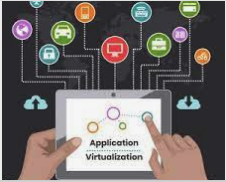
WHAT IS OBSERVABILITY?
Visualisation
Sometimes it is necessary to use visualization tools that provide the current state of the system at a glance.

Slide 11
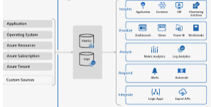
WHAT IS OBSERVABILITY?
Alerting
Even if all the observability components are activated in the system, it may not always indicate what is going on before the alert mechanisms are activated.
In this instance, a requirement to activate a system that monitors the applications 24/7 and draws attention to an unexpected situation is needed.
It is crucial to detect and, if possible, solve the problems that occur in the system before the users—both in terms of user satisfaction and reputation, and in terms of not interrupting the creation of value can be detected with alerts.

Slide 12
IMPLEMENTING OBSERVABILITY

Slide 13
IMPLEMENTING OBSERVABILITY
A plethora of open source tools are available to provide application traceability.
This section will review the open-source projects widely accepted in the industry, favouring those supported by the Cloud Native Computing Foundation (CNF)

Slide 14
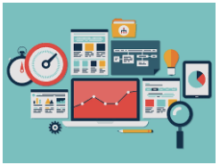
IMPLEMENTING OBSERVABILITY
Monitoring
The monitoring of a service must be able to access the service that needs to be monitored in the same way as would an end user, because the monitoring must be done through the eyes of the end user consuming the service.
For example, if the services are on the same network, it will not be able to observe a DNS service failure or a problem in the data centre’s external network connection.
Therefore, the ideal solution for this application is to install a monitoring application such as Zabbix () outside of the data centre or use one of the Monitoring as a Service (MaaS) applications such as Uptime Robot or Pingdom .

Slide 15

IMPLEMENTING OBSERVABILITY
Logging
Logging in distributed applications causes more than one problem, it cannot be solved with the classical approach.
Considering that distributed applications operate both horizontally and vertically split, all logs should be collected in a centralized system to examine both the logs produced by multiple copies of the same service and the successive logs of the vertically split services that interact with each other.
Instead of a directory where all the logs of this environment are written in plain text, a query-able database where the structural log data is stored is preferred.
The Elastic database is widely accepted in this regard, as it facilitates processing and searching textual data.

Slide 16
IMPLEMENTING OBSERVABILITY
Logging
Elastic’s ELK Stack, which consists of products entirely of the Elastic company, is a centralized end-to-end logging solution with Logstash for transferring logs from the source to the Elastic database and Kibana that handles the visualization of the data.
Fluentd, a CNCF graduate project for log migration, and Grafana for visualization are also widely used.
Regardless of whether or not the application is Cloud Native, the first rule to keep in mind when logging is that logging is done at different levels and those levels are generally accepted and agreed upon.
In other words: Given a classification such as TRACE, INFO, ERROR, FATAL, there must be agreement between the developers as to which levels are used in which case.

Slide 17
IMPLEMENTING OBSERVABILITY
Logging
Which of these levels are actually written to the logging system must be adjusted at runtime, because logging is the most costly of the observability methods, both in terms of network communication and storage space, since it generally requires more data to be written than other methods.
One logging practice that is good practice for monolithic applications, but has become essential for distributed applications, is to use a structured data model such as JSON from the very beginning.
Using a plain text format and trying to parse that format by regular expressions is a fragile process and must be avoided.
This data model must be accepted and standardized by all teams developing different services so that the log records written by different services can be examined together.

Slide 18
IMPLEMENTING OBSERVABILITY
Metrics Collection
It was mentioned that metrics are measurable numerical values and that they can indicate what the system looks like at that moment.
Also, if this data is kept in the form of a time series, it can give an idea of what the system will look like in the future.
Prometheus, which is the second project to reach graduate status in the CNCF landscape has been widely accepted by industry in this regard.
Prometheus is a product that can be configured to consume a RESTful service that publishes metrics at specified intervals according to specified standards and can store these metrics as a time series.
The Prometheus project also includes pre-built metrics for many programming languages and libraries that provide the ability to open a RESTful service to publish metrics.

Slide 19
IMPLEMENTING OBSERVABILITY
Metrics Collection
Work continues to establish Prometheus’ metrics publishing format as an industry standard under the Open Metrics project by the CNCF.
Metrics data (even the integer values such as the number of visits) are always stored as floating-point decimal numbers and are basically divided into two categories—counter and gauge
Counter
The counter type stores data that is used to hold continuously increasing values.
This data type can be compared to the odometer in cars.
For example, storing constantly increasing values such as the number of requests to the service or the number of errors encountered in the application as counter type data.
In addition, business-oriented metrics such as the number of viewers and the number of buyers of a product can also be stored in the counter type and used to support business decisions.

Slide 20
IMPLEMENTING OBSERVABILITY
Metrics Collection
Metrics data (even the integer values such as the number of visits) are always stored as floating-point decimal numbers and are basically divided into two categories—counter and gauge
Gauge
The gauge type is used for values that can move back and forth within two specified reference ranges.
This data type can be compared to the data of a speedometer in cars.
You can store values such as instantaneous CPU and memory usage, error/request rate in the gauge type.
Moreover, business-oriented metrics such as the purchase rate of goods added to a cart are often suitable for gauges.
As with all monitoring methods, there are myriad options for metrics that can be pursued.
Trying to keep track of all metrics may lead to overlooking the metrics that really matter.
Therefore, it would be a better approach to start with a limited set and add metrics that will be useful over time.

Slide 21
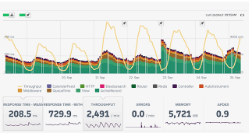
IMPLEMENTING OBSERVABILITY
The Application Metrics
The simplest to implement and easiest to understand approach for applications is the RED pattern proposed by Google.
RED Pattern
This pattern, which is recommended for web-based services, is produced from the first letters of Request, Errors, and Duration.
According to its creators, it suffices to track the number of requests for each service, the number of errors received among these requests and the time to respond to these requests.
This approach was especially adopted by the Google Site Reliability Engineering (SRE) teams, and they defended the fact that all services are tracked with the same metrics, claiming that it makes the job much easier for the first responder teams that follow the services.
Container Solutions’ Cloud Native Operations service is modelled after the same approach.

Slide 22
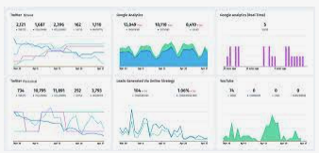
IMPLEMENTING OBSERVABILITY
Business Metrics
There are a great deal of metrics that businesses can follow to make business sense (such as the rate of conversion of home page visits to sales).
Likewise, the number of views of the help pages, which may be meaningful for the team that develops and works for the health of the system, or increasing visits to your service status page (e.g. https://status.azure.com/en-us/status) may mean something is wrong with the system.

Slide 23
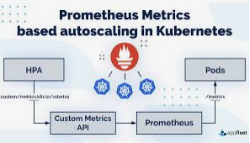
IMPLEMENTING OBSERVABILITY
Kubernetes Metrics
Kubernetes provides tools that allow for the collection of metrics about the platform.
At the most basic level, Container Advisor, a tool developed by Google, collects resource utilization and performance metrics for containers.
Based on the metrics generated by this tool, Kubernetes decides on which node to run a new pod on, or whether to expand horizontally.
In addition kube-state-metrics can collect metrics on all Kubernetes objects (nodes, pods, deployments, etc.) created by the Kubernetes API and make them available in a format that can be consumed by Prometheus via the /metrics endpoint on port 8080.
As you can imagine, hundreds of metrics are published through this interface, and the number of metrics is increasing daily as the project progresses.
For up-to-date information on metrics, see the project documentation .
Again, it would make sense to start with a set that can provide the most benefit in the short term, and expand the scope of tracking over time. Below isa good starting set of metrics on different aspects of Kubernetes.

Slide 24
IMPLEMENTING OBSERVABILITY
Kubernetes Metrics
Cluster Health Metrics
To monitor the health of the Kubernetes instances, the following set of metrics is recommend :
Node count and health
Per node and total resource amount and usage

Slide 25
IMPLEMENTING OBSERVABILITY
Kubernetes Metrics
Pod/Container Metrics
Tracking the following metrics for the pods and containers running on Kubernetes:
Number of pods per node and total
Resource usage for each container and its request and limit information
Liveness/Readiness states for each pod
Container/Pod restart counts
Input/output network traffic for each container

Slide 26
IMPLEMENTING OBSERVABILITY
Kubernetes Metrics
Deployment Metrics
Examining the following metrics for all deployment definitions helps quickly identify the issues and predict the problems that might occur:
Number of deployments
Number of replicas defined for each deployment
Number of replicas that aren’t available for each deployment

Slide 27
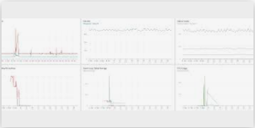
IMPLEMENTING OBSERVABILITY
Runtime Metrics
Ready-made metrics libraries for programming languages can also publish many metrics about the runtimes of these languages.
Observing these metrics in accordance with the language used is also critical for monitoring the health of the application:
Number of active processes/threads/virtual threads
Heap and stack usage
Non-heap memory usage (if supported by the language used)
Garbage collector run and pause times (if supported by the language used)
Number of files kept open
Number of network ports kept open.

Slide 28
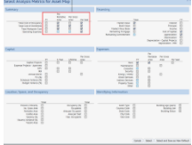
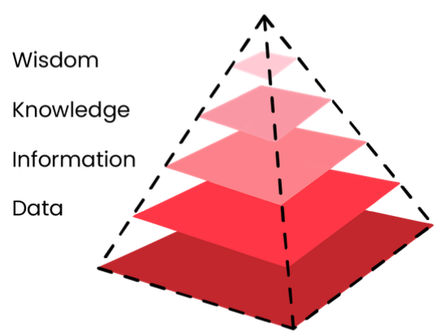
IMPLEMENTING OBSERVABILITY
Analysis of Metrics
A variety of metrics we can be collected across the applications, services and platforms, but collecting metrics alone is not meaningful.
These metrics need to be properly processed and turned into actions.

Slide 29
IMPLEMENTING OBSERVABILITY
Analysis of Metrics
Mean, Median, Percentile
To process data collected in the form of time series, the first thing that comes to mind is the average of the values.
The mean is determined by adding all the values and dividing by the number of samples. The mean increases due to an outlier sample and 90% of the population appear to be below average in size.
Although the median, defined as the middle value after sorting a sample set, is more successful than the mean in terms of outliers, it still only gives good results in cases where the distribution is better, just like the mean.
The calculation of the percentile is based on grouping all samples into percentile intervals.
In this way, you can obtain more sensitively grouped data and prevent outliers from skewing the data.

Slide 30

IMPLEMENTING OBSERVABILITY
Tracing
Jaeger, a CNCF graduate project for tracing, is the most commonly used application for distributed tracing.
Formed through the merger of OpenTracing and OpenCencus, the CNCF’s OpenTelemetry project provides a standardised format for telemetry data - both traces and metrics.
It already enjoys wide vendor support including from Amazon (AWS X-Ray), Dynatrace, Google Cloud Monitoring + Trace, Honeycomb, Lightstep, Microsoft (Azure Monitor), New Relic and Splunk, as well as support for open source tools such as Prometheus and Jaeger.
Supported languages include Go, JavaScript, Java, Python, Ruby, PHP, Objective-C, C++ and C#.

Slide 31
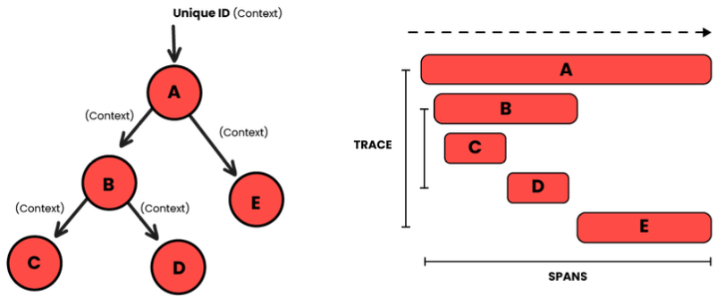
IMPLEMENTING OBSERVABILITY
Tracing
OpenTelemetry traces a record of activity for a request through a distributed system.
A trace is a Directed Acyclic Graph of spans.
Spans are named, timed operations representing a single operation within a trace.
Spans can be nested to form a trace tree.
Each trace contains a root span, which typically describes the end-to-end latency and (optionally) one or more sub-spans for its sub-operations.

Slide 32
IMPLEMENTING OBSERVABILITY
Tracing
Service Mesh
Although this is not the only task it performs, it is worth mentioning Service Mesh tools in this context.
The best known Service Meshes are Linkerd (pronounced Linker-DEE), a CNCF project originally created by Buoyant, , and Istio, developed by Google and IBM in partnership with the Envoy team from Lyft.
Service Mesh applications take the sidecar approach by leveraging Kubernetes’ ability to run multiple containers within a pod.
These sidecar proxy applications which are injected into each pod, monitor traffic by routing it through itself, and both products write this data to the Prometheus database. (Linkerd uses a proxy developed under its own project, Istio uses Envoy Proxy, another CNCF project).

Slide 33
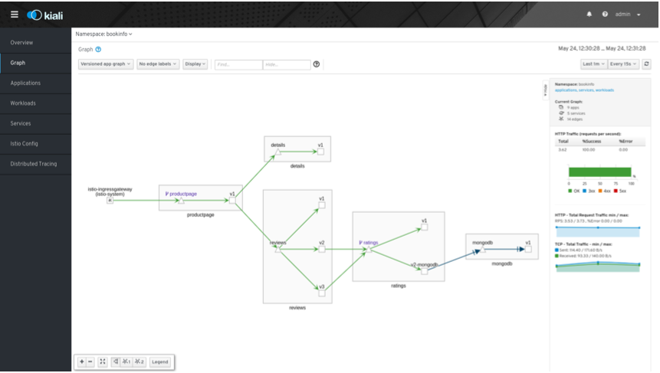
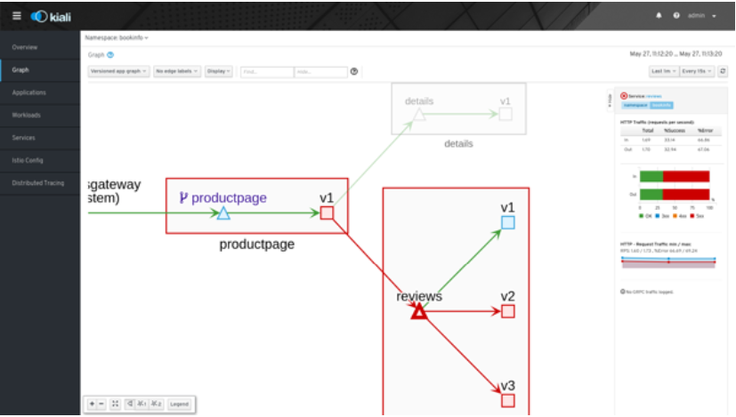
IMPLEMENTING OBSERVABILITY
Tracing
Service Mesh
In addition to telemetry data, this traffic data can also be used for visualization on the topology map with products developed specifically for this task.
Kiali, developed by Red Hat, can display the topology of services, including the data such as communications between the services, the health of services, and the load distribution between versions of services.

Slide 34
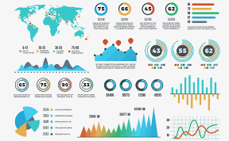
IMPLEMENTING OBSERVABILITY
Data Visualisation
Although collecting the data is important, it is equally important that the data colleced under the title of observability is easily understood, that changes in the data are easily noticed, and that the actions to be taken are easily determined.
There is no point in collecting data not act upon.
Raw digital data needs to be converted into visual data.
Grafana is perhaps the most widely used product for this because of the variety of data sources it can directly connect to and its rich visualization capabilities.
Grafana can be used for far more extensive visualization work.
Tom Wilkie of Weave Works recommends combining the visualization of RED metrics for all services in a single dashboard.
It is claimed that viewing all services from the same point of view on a single screen in this way is much easier for people following the metrics to perceive.
In the example below, Rate and Error data is visualized in the left graph and Duration data is visualized in the right graph for each service.

Slide 35
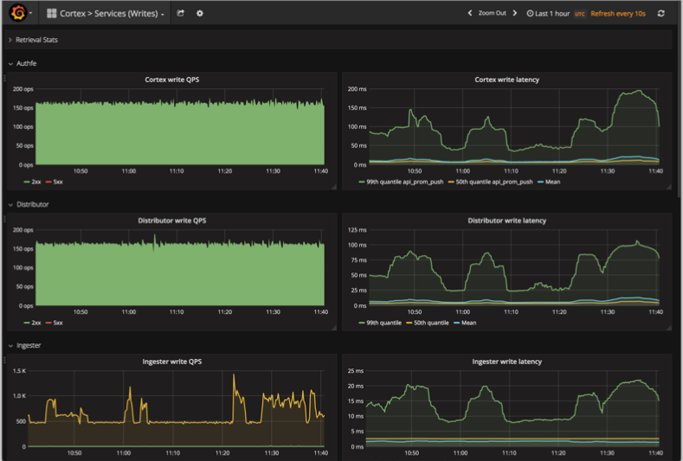
IMPLEMENTING OBSERVABILITY
Data Visualisation (Example)

Slide 36
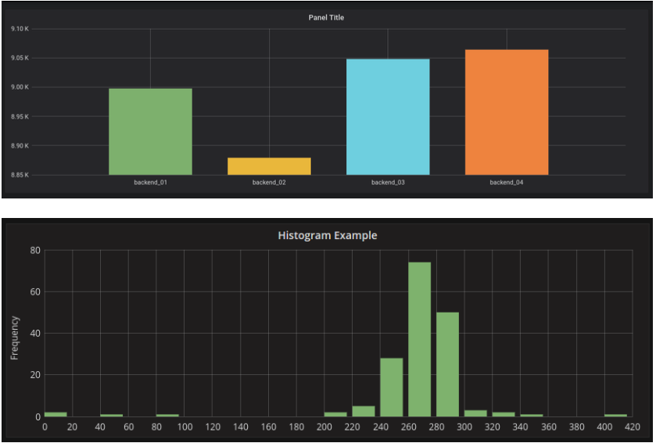
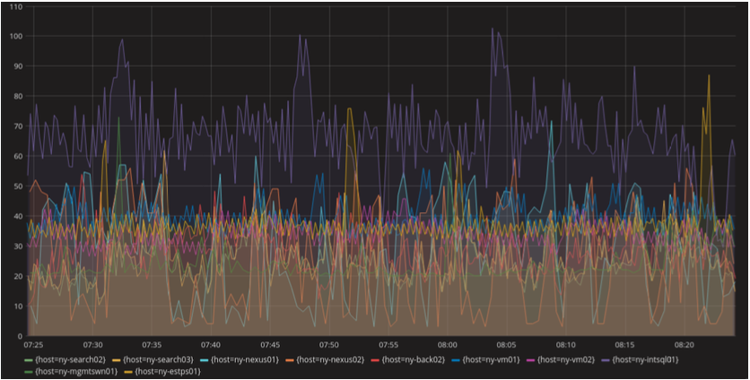
IMPLEMENTING OBSERVABILITY
Data Visualisation
Graph
It can be used as Line, Bar and Histogram. It is used to show the change in data as a function of other data or time.

Slide 37
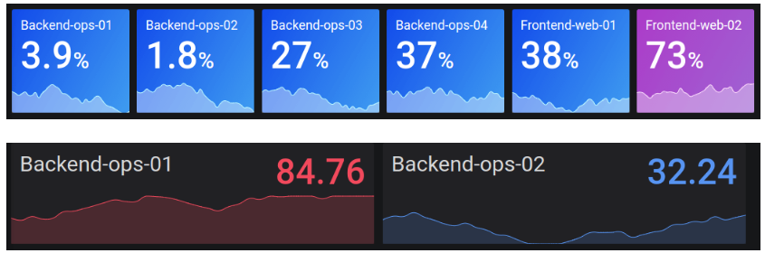
IMPLEMENTING OBSERVABILITY
Data Visualisation
Stat
It is often used to indicate one or more values that should be seen at a glance. It is particularly well suited for summary information.

Slide 38
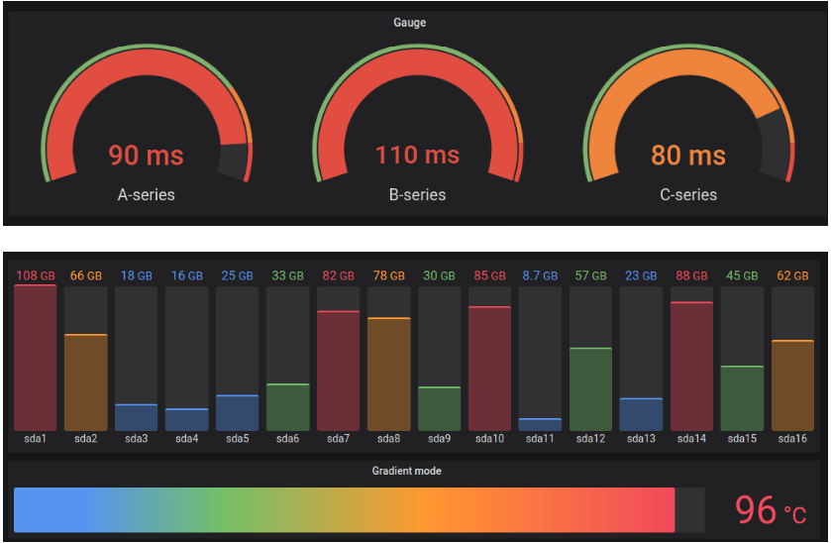
IMPLEMENTING OBSERVABILITY
Data Visualisation
Gauge
Ideal for visualizing data types with an upper limit. It can be used in standard or bar mode.

Slide 39
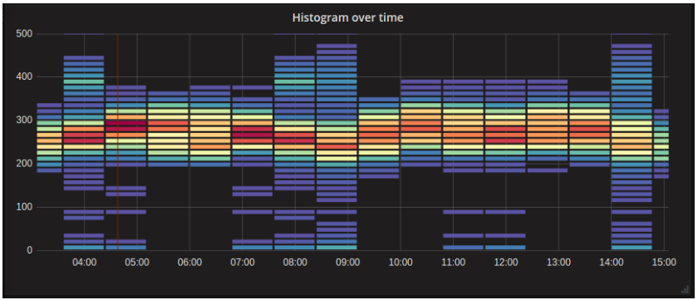
IMPLEMENTING OBSERVABILITY
Data Visualisation
Heatmap
It is particularly used for the time-dependent display of histogram data. It is ideal for seeing in which groups data grouped as histograms concentrate over time.

Slide 40
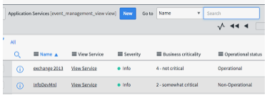
IMPLEMENTING OBSERVABILITY
Alerting
Tools that collect metrics data, such as Prometheus, also allow the creation of rule-based alerts on those metrics.
However, a single problem in the system may generate data that triggers alerts on several different metrics, or it may repeatedly generate the same alert at certain intervals if a metric remains above/below the warning threshold for a certain period.
In addition, these systems have no information about who and how the warning is transmitted.
Therefore, an application is needed to manage alerts. These applications should have the following functions:

Slide 41
IMPLEMENTING OBSERVABILITY
Alerting
Therefore, an application is needed to manage alerts. These applications should have the following functions:
Grouping: The alert system should be able to group alerts that are known to be related and send them to recipients as a single notification.
For example, alerts from multiple services that have a connection problem to a common database should be able to be converted into a single notification containing the relevant database information and a list of services that could not be reached.

Slide 42
IMPLEMENTING OBSERVABILITY
Alerting
Therefore, an application is needed to manage alerts. These applications should have the following functions:
Blocking: The alert system should not notify on other alerts that it knows are related to an alert that has already been notified.
For example, if a notification has been made about a malfunctioning cluster, alerts from services running on that cluster should be prevented until the alert about the cluster is resolved.

Slide 43
IMPLEMENTING OBSERVABILITY
Alerting
Therefore, an application is needed to manage alerts. These applications should have the following functions:
Silencing: For any warning, it should be possible to silence it for a certain time after the warning is received.
For example, if it takes half an hour to reboot a system and this is a known and accepted situation, warnings that come in up to half an hour after the first warning should be ignored.

Slide 44
IMPLEMENTING OBSERVABILITY
Alerting
Since the products/companies (Microsoft, VMware, etc.) that typically provide infrastructure systems supply alerting systems internally, and these products can also relay the alerts they receive from third party systems, companies tend to integrate them with the existing alerting systems.
However, if you don’t have such a product, Prometheus Alertmanager can be used as a
component within Prometheus that provides the above features (or even more).
The goal with alert systems is to send as few notifications as possible.
Otherwise, the alert system could become a “liar shepherd” and cause the really important alerts to be overlooked.
This is where you can impose a rule to not miss alerts that should be sent.
Another point that should never be overlooked in a warning system is that it must be redundant and fully observable.

Slide 45
CONCLUSION

Slide 46
CONCLUSION
There are several valid reasons for migrating applications to a distributed architecture.
Horizontal extensibility, efficient use of resources, zero downtime deployments, ability to perform A/B testing are some of them.
However the more distributed the applications become, the more complex they become and the more difficulties arise with monolithic applications.
For example, to merge the log records that are already together in the monolithic application regardless of the method, or to implement techniques like tracing that is not needed in monolithic applications.
True “observability” is no longer a goal that can be achieved with a single tool and the push of a few buttons.
However, thanks to organizations like CNCF and the companies that support these organizations, it is not an unattainable goal.
Many open-source tools have been developed for this purpose, and the support of the open-source communities that develop and use these tools, it is possible to make the applications observable with the right tools and the right tactics, taking the users’ satisfaction to a higher level.

Slide 47
Distributed tracing in practice
Ivo Mägi, CEO & product manager @ Plumbr
September 2019

Slide 48
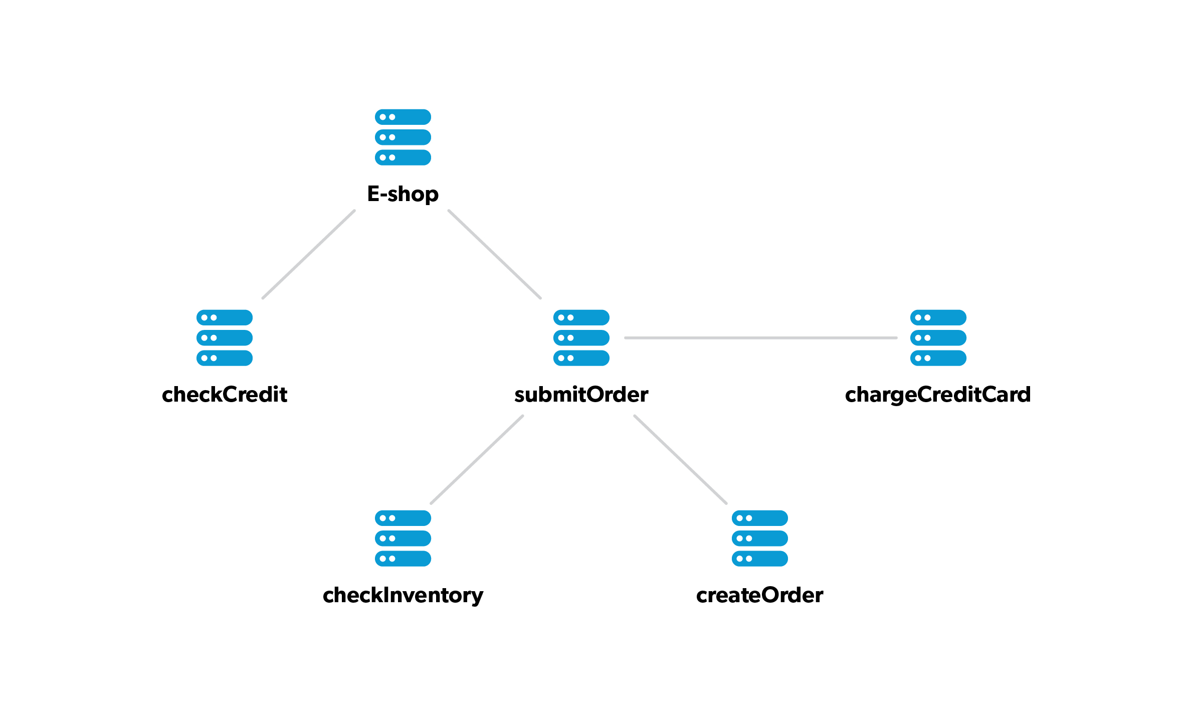
Notes:
Kas suudame seda protsessi kuidagi lihtsalt animeerida? Mikroteenuste pildi peal?
Ülevalt tuleb päring sisse
Esimese node juures luuakse ID (midagi automaatset, a la sdv0894vöeb8sv) ja registreeritakse alguse aeg
Päring liigub teise node juurde
Teise node juures on sama ID ja rügatakse alguse aeg
Päring liigub kolmanda node juurde
Kolmanda juures sama ID ja alguse ning lõpu aeg
Päring liigub tagasi teise node juurde, teine node saab lõpuaja
Liigub tagasi esimese node juurde, esimene saab lõpuaja
Liigub ülevalt välja
Kõikidest nodedest liigub info monitooringu keskserverisse

Slide 49
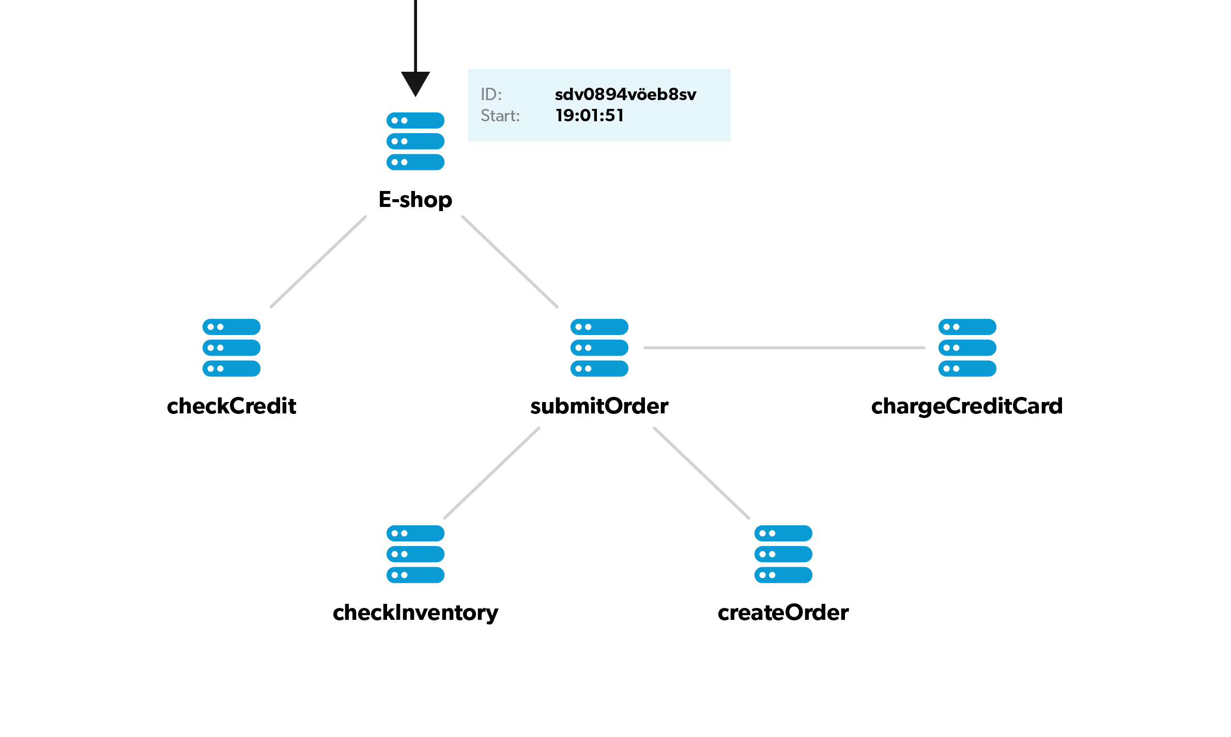

Slide 50
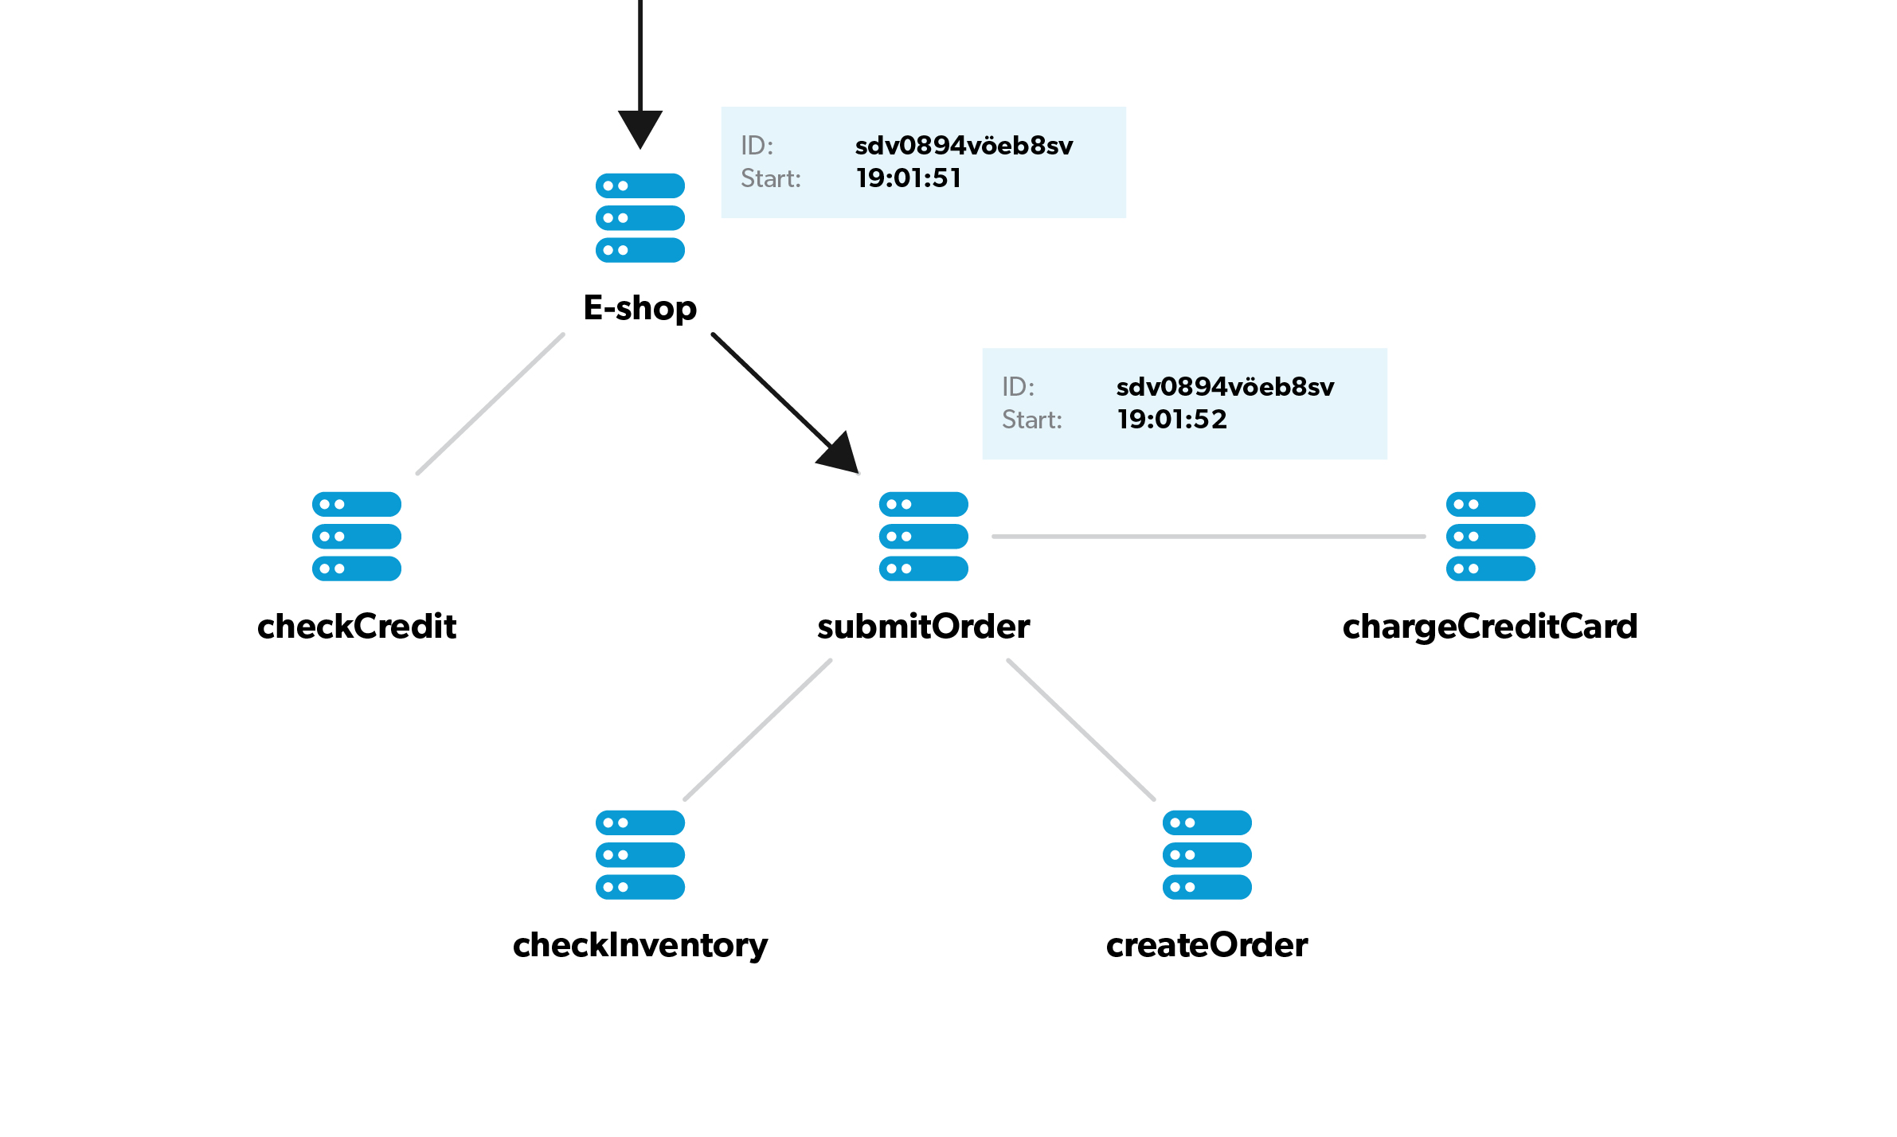

Slide 51
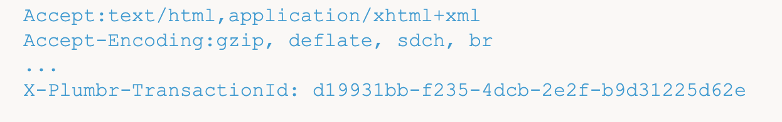
Passing the UUID: HTTP-headers

Slide 52
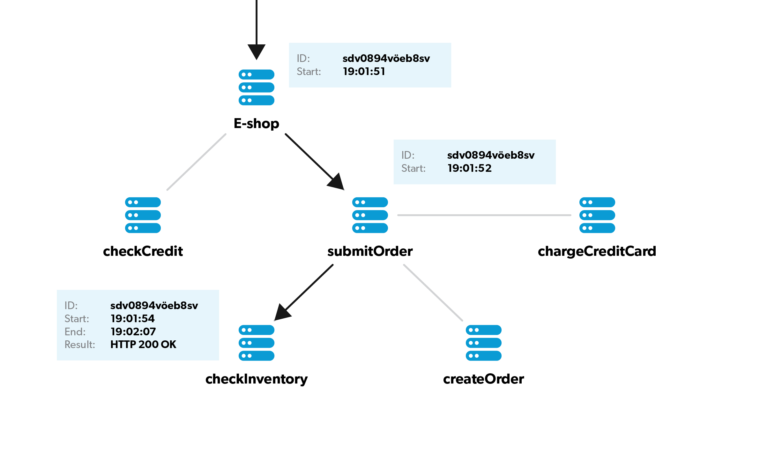

Slide 53
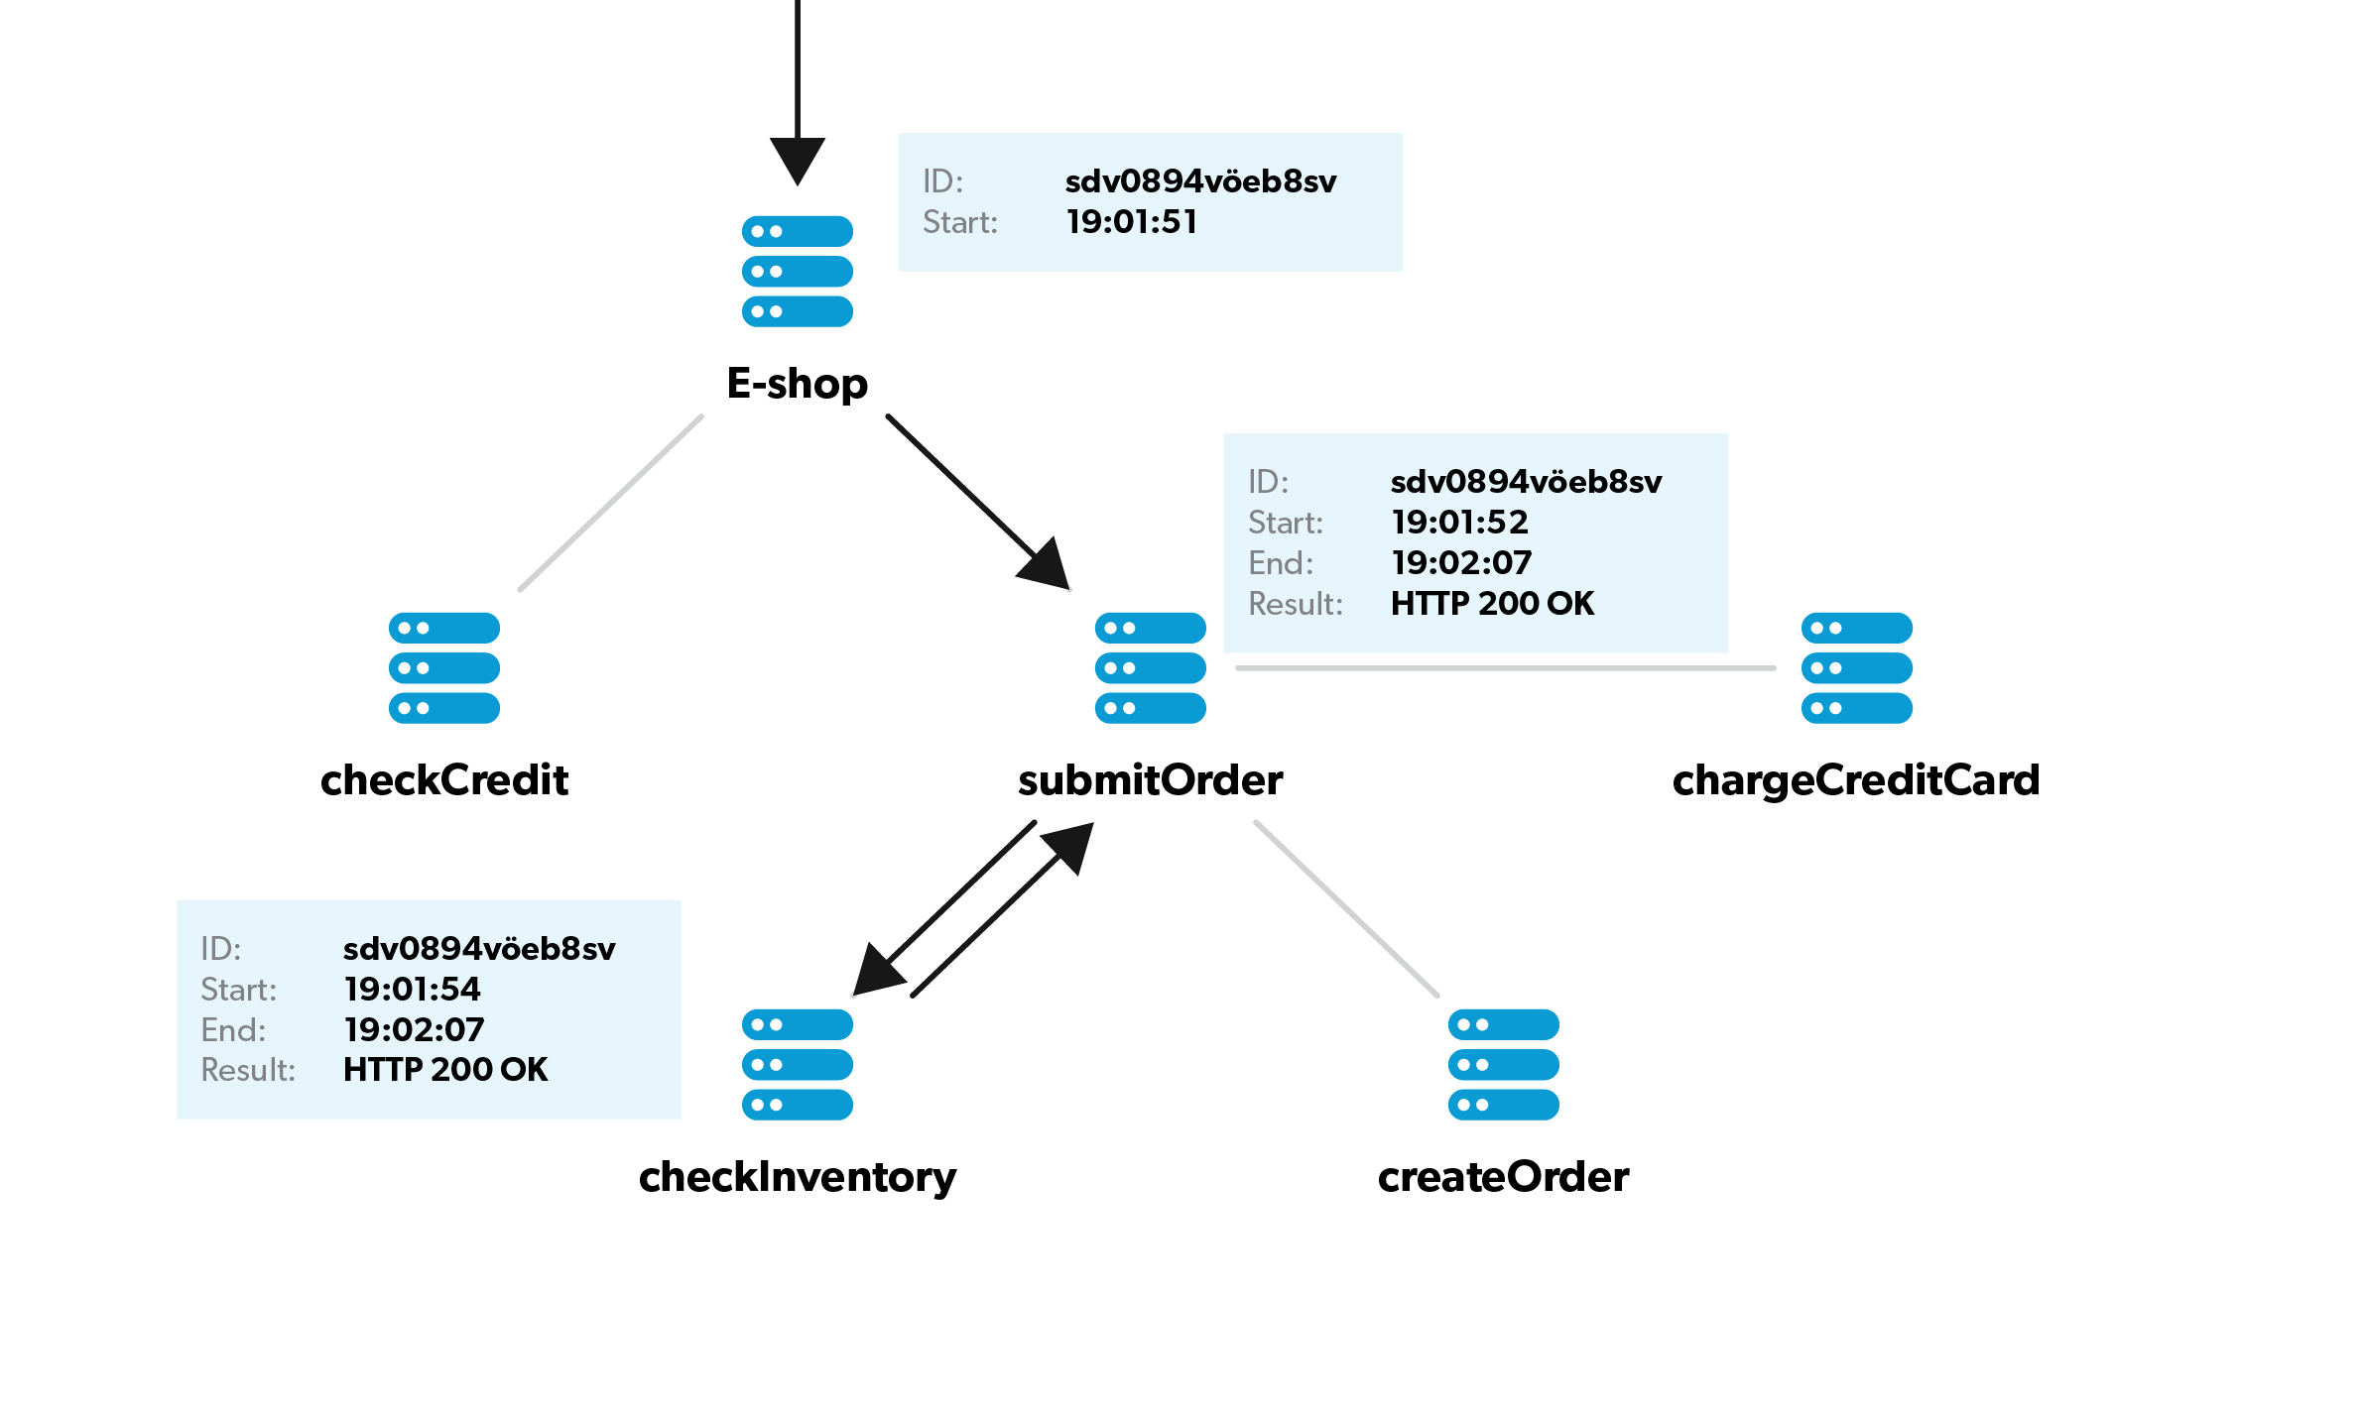

Slide 54
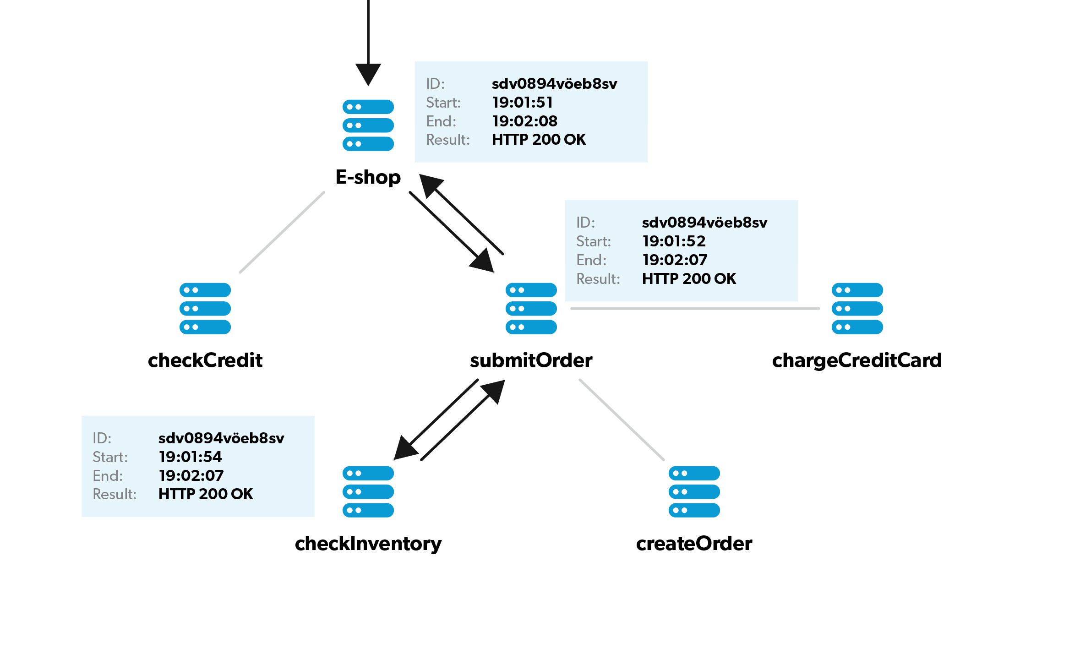

Slide 55
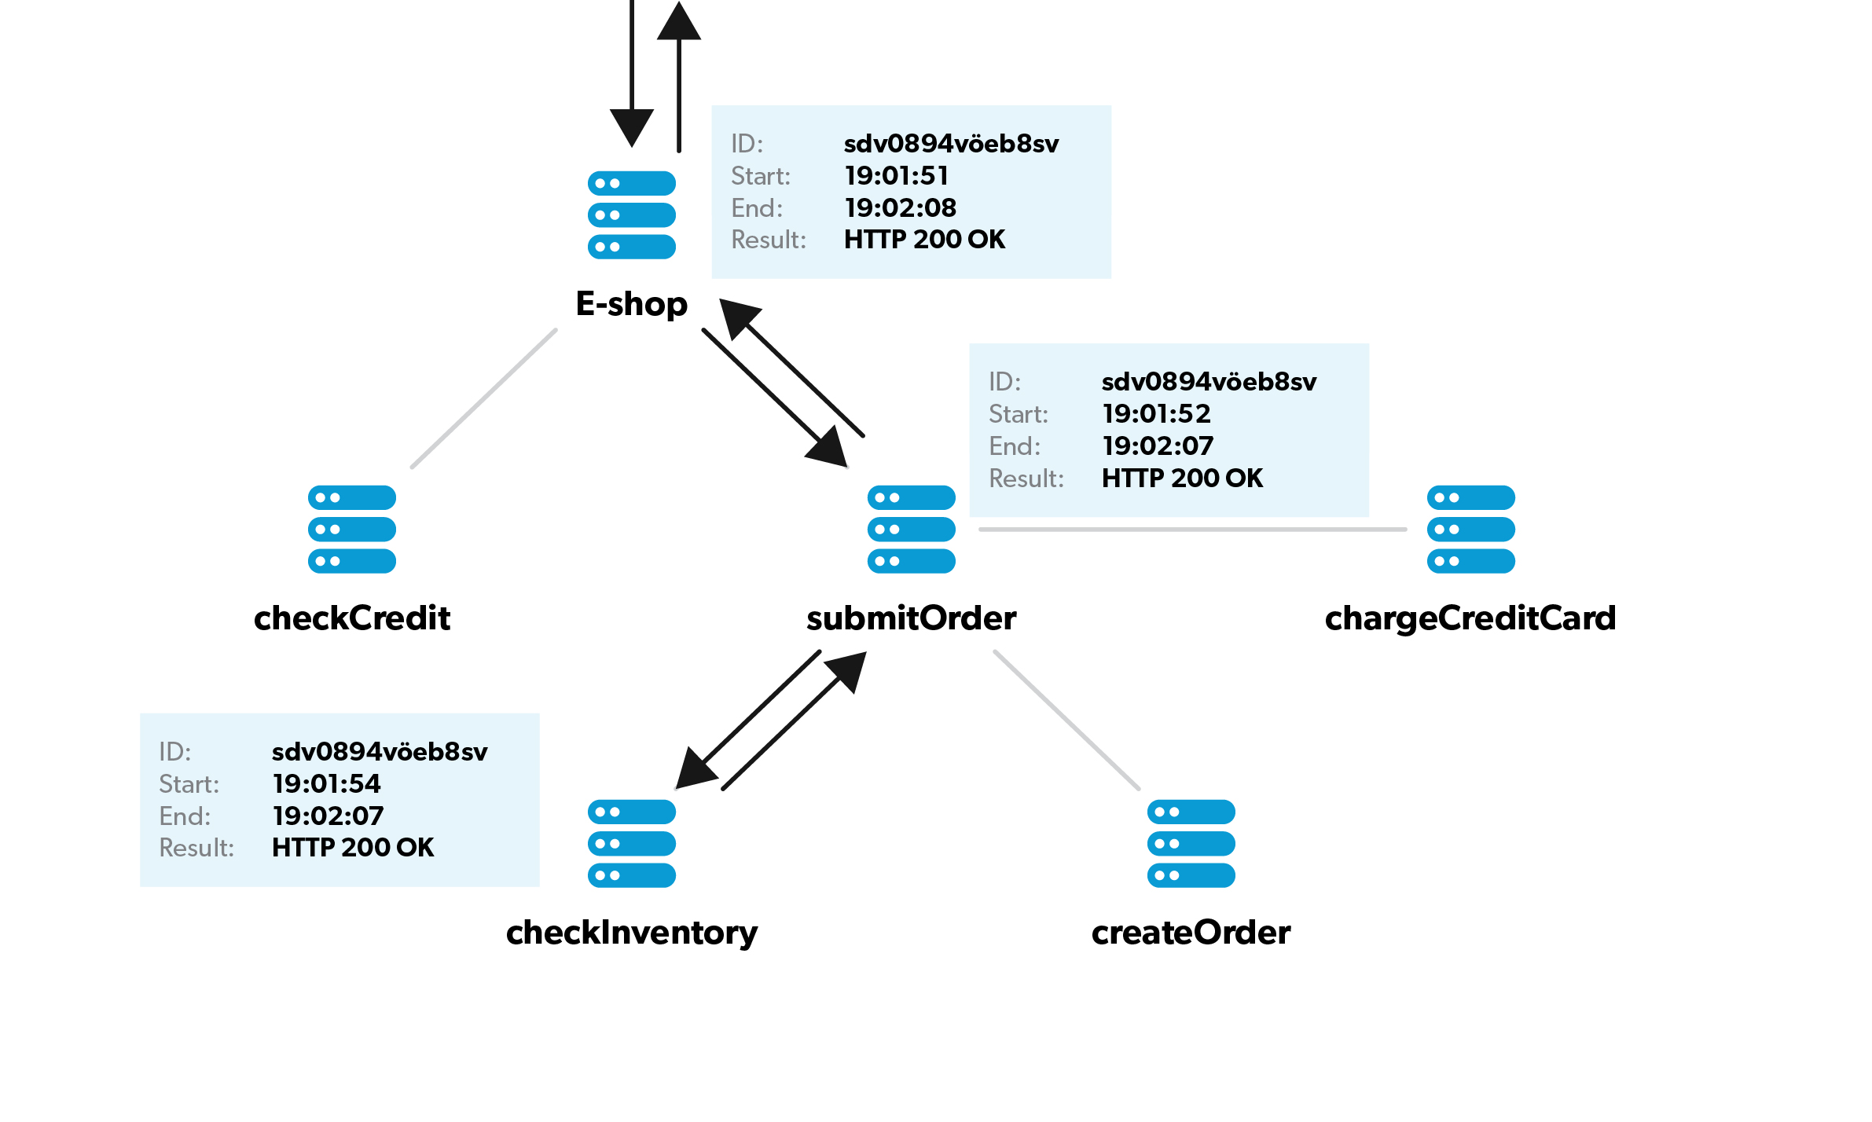

Slide 56
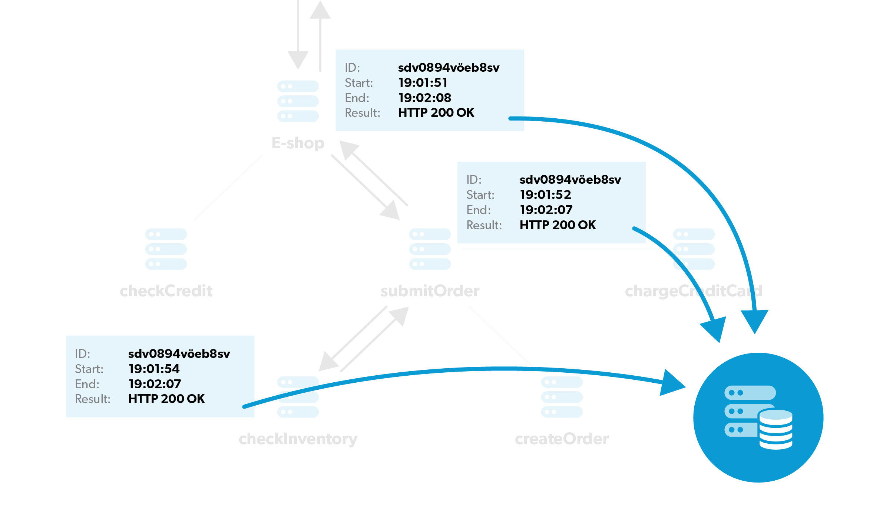
Notes:
The last piece of all tracing infrastructure is the monitoring agents themselves.
Monitoring agents are a work of software craft by themselves.
The common denominator among all web applications is http or https traffic.
Therefore it is a common practice to have agents that can operate at the lowest levels so that they can capture the complete details of traffic between all the nodes in an application.
Agents must be able to capture and analyze traffic in a manner that is agnostic to languages, frameworks, and other infrastructure.
Such agents are built either using the language-specific APIs at bytecode level (such as Java or .NET agents) or dig deeper and hook into system library calls via LD_PRELOAD at native code level.

Slide 57
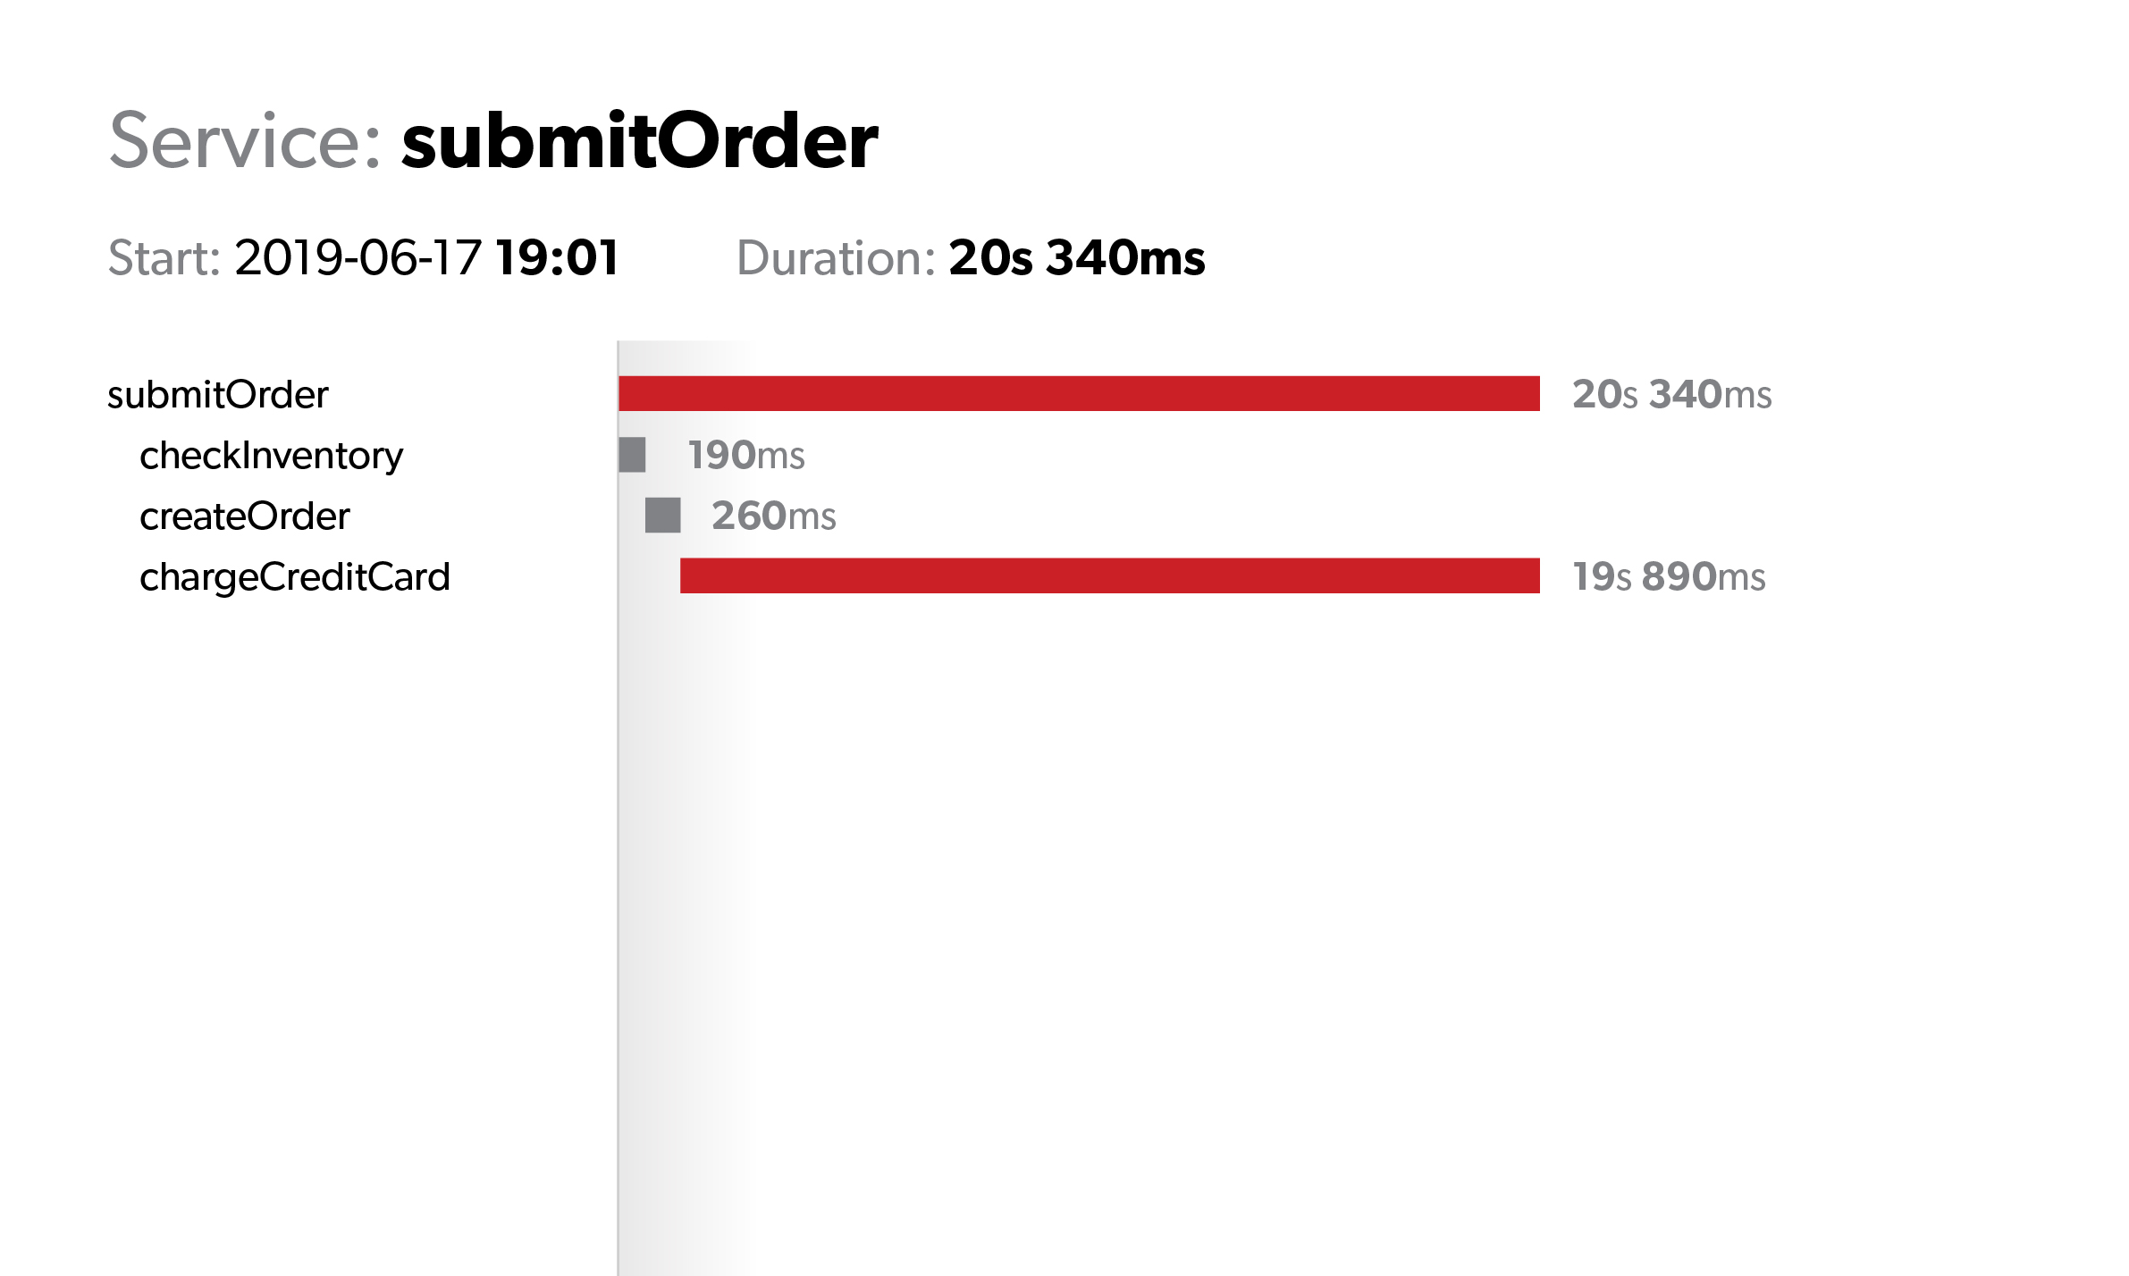
Outcome: distributed trace
Consisting of spans
Registering the duration and outcome of the trace
Enriched with additional metadata at span/trace level:
User ID
Cluster the span belongs to
Node ID of the span
…

Slide 58
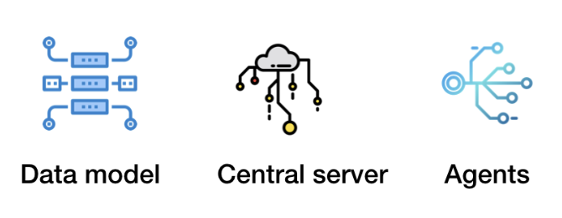
Summary: three building blocks for distributed tracing
Notes:
So we covered the concept. Distributed tracing builds up a data model, consisting of traces and spans which are uniquely identified and contain valuable metadata. This data is captured by agents, deployed per microservice under monitoring. The data is sent to the central server where it is processed and made available for querying and visualization.

Slide 59
Put the distributed traces into good use
Removing the need to manually reproduce and gather evidence when responding to support tickets
Fully understanding the impact of user-facing issues
Prioritizing the improvements based on the impact to end user
Proactively responding to issues via alerting based on the tracing information
Notes:
I bet your mind is already racing a million miles a minute, thinking about all the cool things that can be done given such information, right? Let me show you three examples, going from a simple and straightforward use case to something I bet you never even thought about:

Slide 60
Hypothetical support case landing on your desk
From: John
To: support@example.com
Subject: Cannot complete checkout
I just tried to complete the order #32828, but was unable to finish the checkout. Your app stalled for 20 seconds and then gave me an error.

Slide 61
…. two weeks later
From: John
To: support@example.com
Subject: Re:Re:Re:Re:Re:Cannot complete the checkout
Managed finally capture the HAR file from my browser using the instructions you altered. However it is too big to be sent as email attachment. Please advise

Slide 62
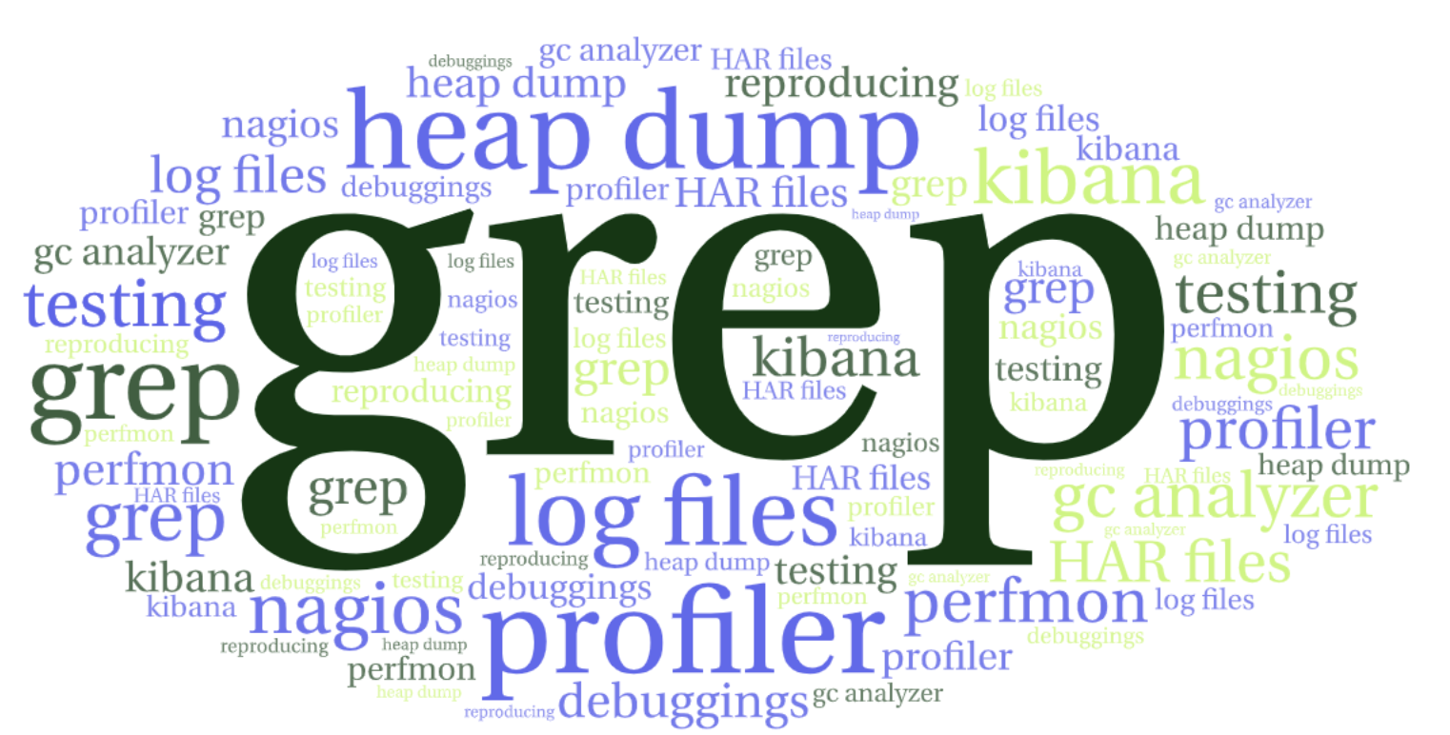
What happened during the two weeks?

Slide 63
Could it have been different?
Yes. Lets walk through examples understanding how distributed tracing helps you by:
Verifying the claim
Prioritizing the response
Understanding the true impact
Proactively handling such problems

Slide 64

Example #1: verifying the complaint

Slide 65
Example #1: verifying the complaint
Notes:
Just as easily, you are now able to confirm that the customer complaint is real - evidence is right in front of you. No more trying to reproduce or gathering additional evidence. You see the failure right in front of you. So you can confirm the presence of the issue and proceed with fixing the bug right away. Right?

Slide 66
Example #1: complaint verified
Metadata added to the trace allowed us to search for the evidence
Spans linked to the trace allowed us to verify the failure had indeed occurred
Notes:
Just as easily, you are now able to confirm that the customer complaint is real - evidence is right in front of you. No more trying to reproduce or gathering additional evidence. You see the failure right in front of you. So you can confirm the presence of the issue and proceed with fixing the bug right away. Right?

Slide 67
Example #2: prioritizing the response

Slide 68
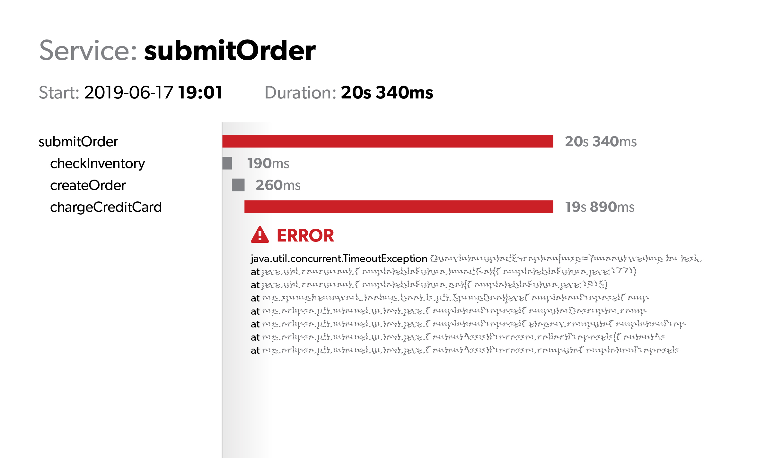
Example #2: prioritizing the response

Slide 69
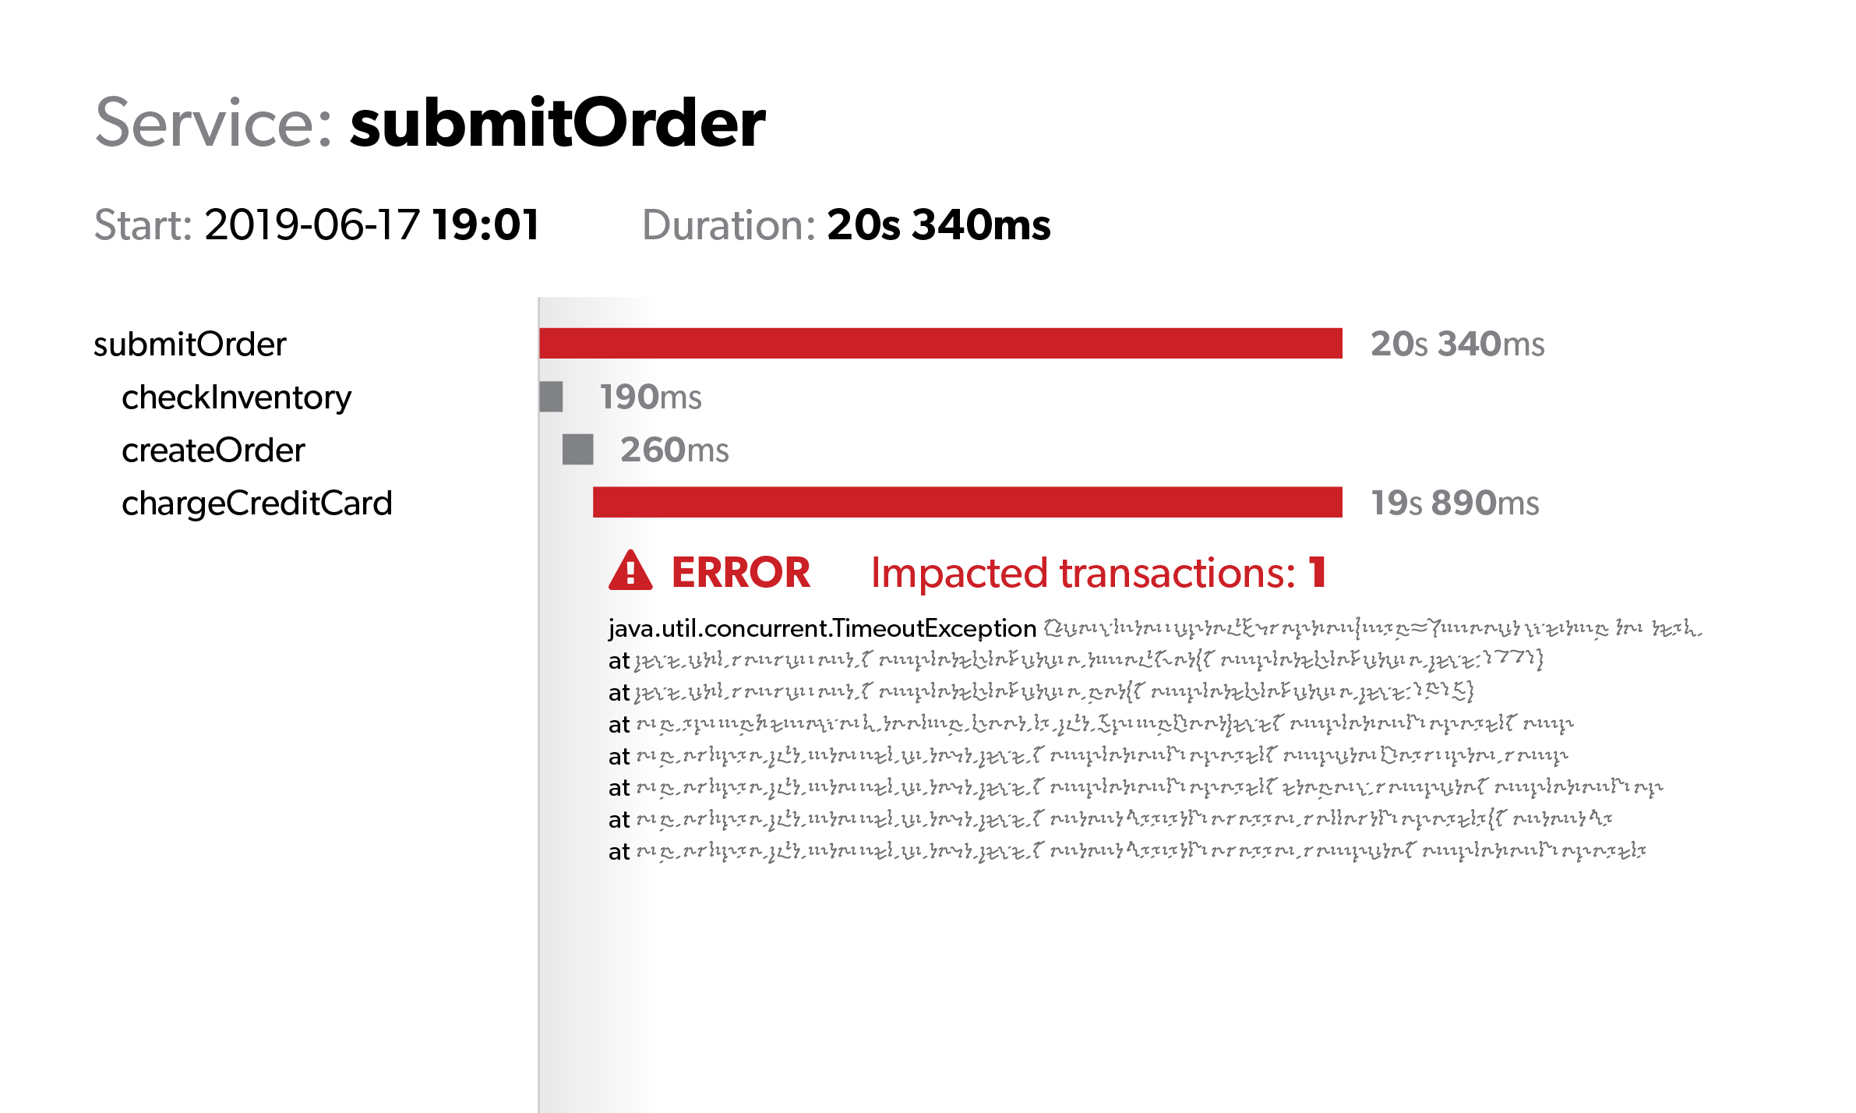
Example #2: prioritizing the response
Notes:
Hm. Now you still have the evidence right in front of you. John Smith indeed was unable to complete the checkout, but apparently he was the only one experiencing this error. Should you really spend your time on this issue, considering all the other bugs and features waiting for your attention in the backlog?

Slide 70
Example #2: priorities assigned based on the impact
Unique identification of an error coupled with distributed tracing allows you to objectively quantify the priority for a particular error.
In the specific situation, (a high priority) response is likely not justified.

Slide 71
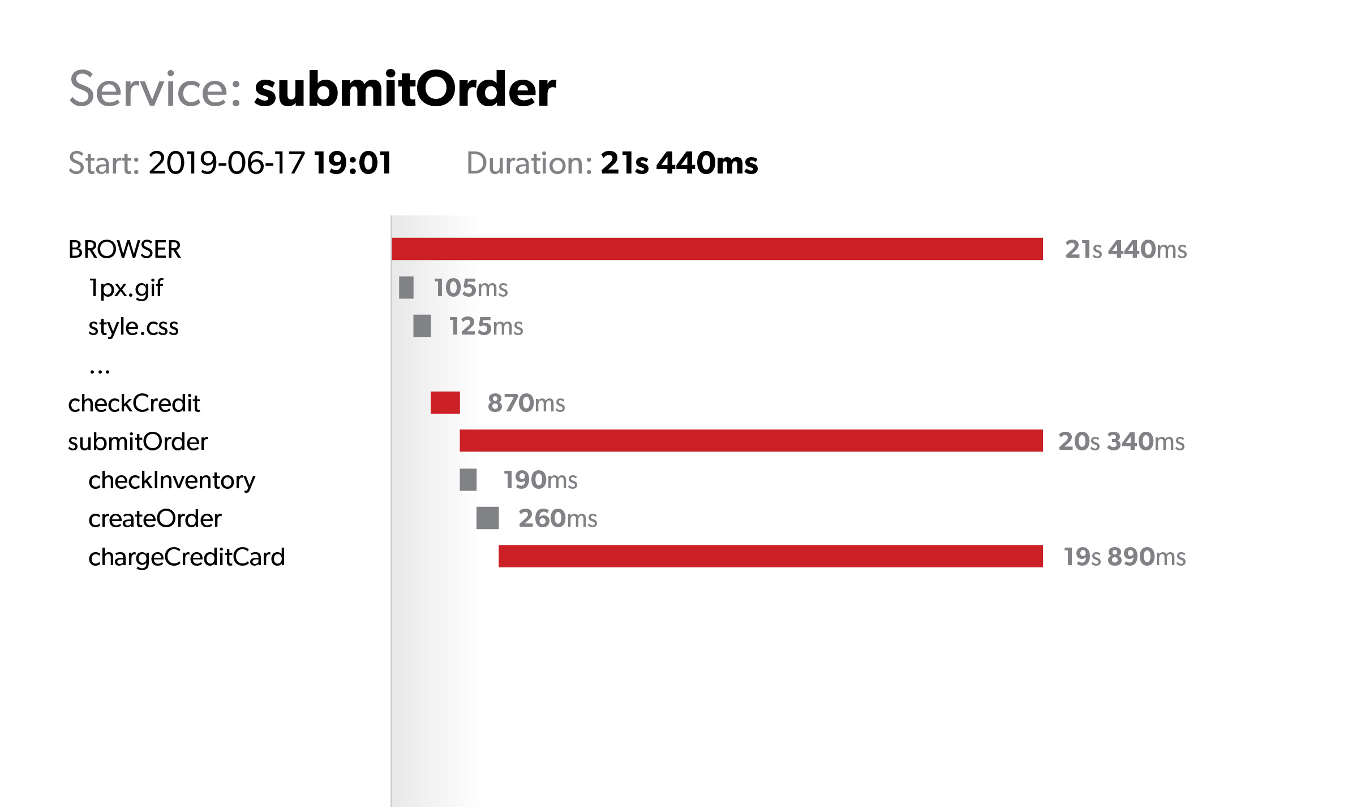
Example #3: zooming out to see what real users experience
Notes:
Whoa. So it was not the checkout all along. It was the subscription details that was the culprit. Apparently the failure to fetch subscription details was not handled properly and thus a non-existing subscription ID was passed to the checkout. But the subscription detail API has been failing for hours now, for hundreds of users. Houston, P1!

Slide 72
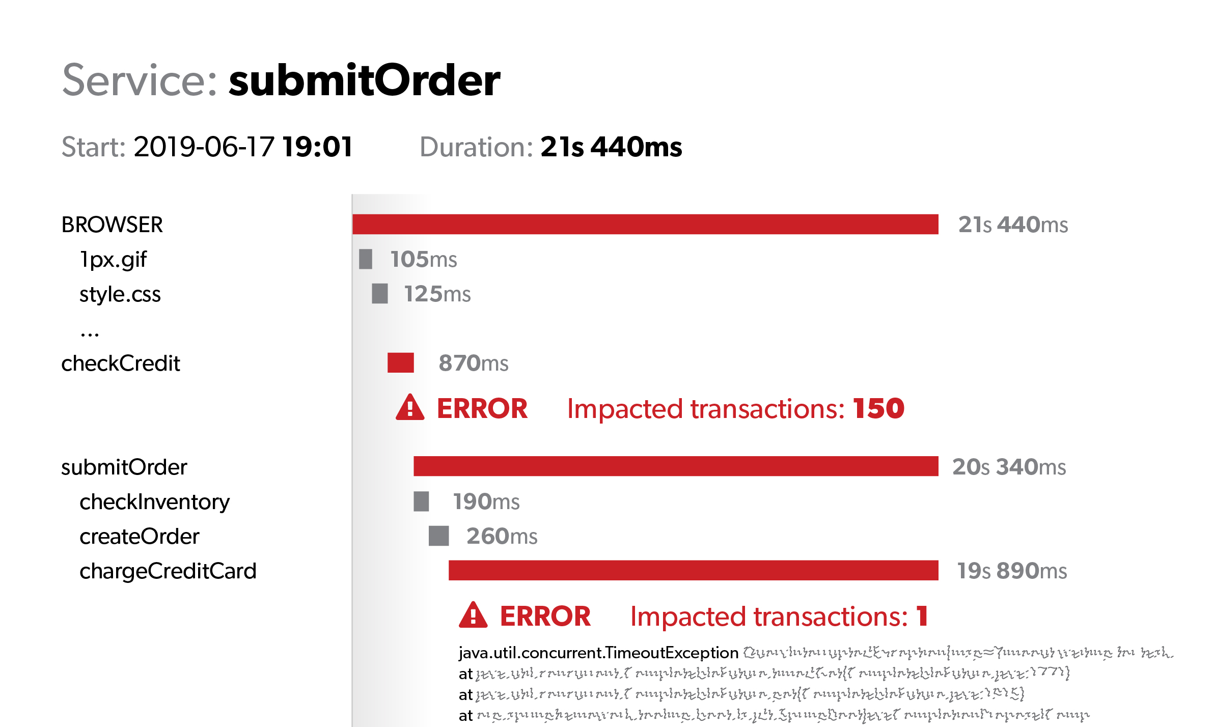
Example #3: zooming out to what real users experience
Notes:
Whoa. So it was not the checkout all along. It was the subscription details that was the culprit. Apparently the failure to fetch subscription details was not handled properly and thus a non-existing subscription ID was passed to the checkout. But the subscription detail API has been failing for hours now, for hundreds of users. Houston, P1!

Slide 73
Example #3: true impact only reveals itself if traces go all the way to real user
Distributed tracing can and should leave the server rooms
End-to-end traces are the way to expose both the impact and root cause correctly

Slide 74
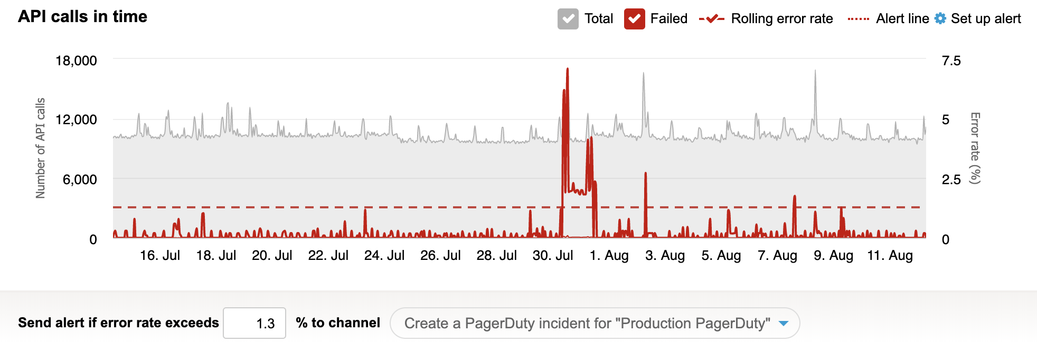
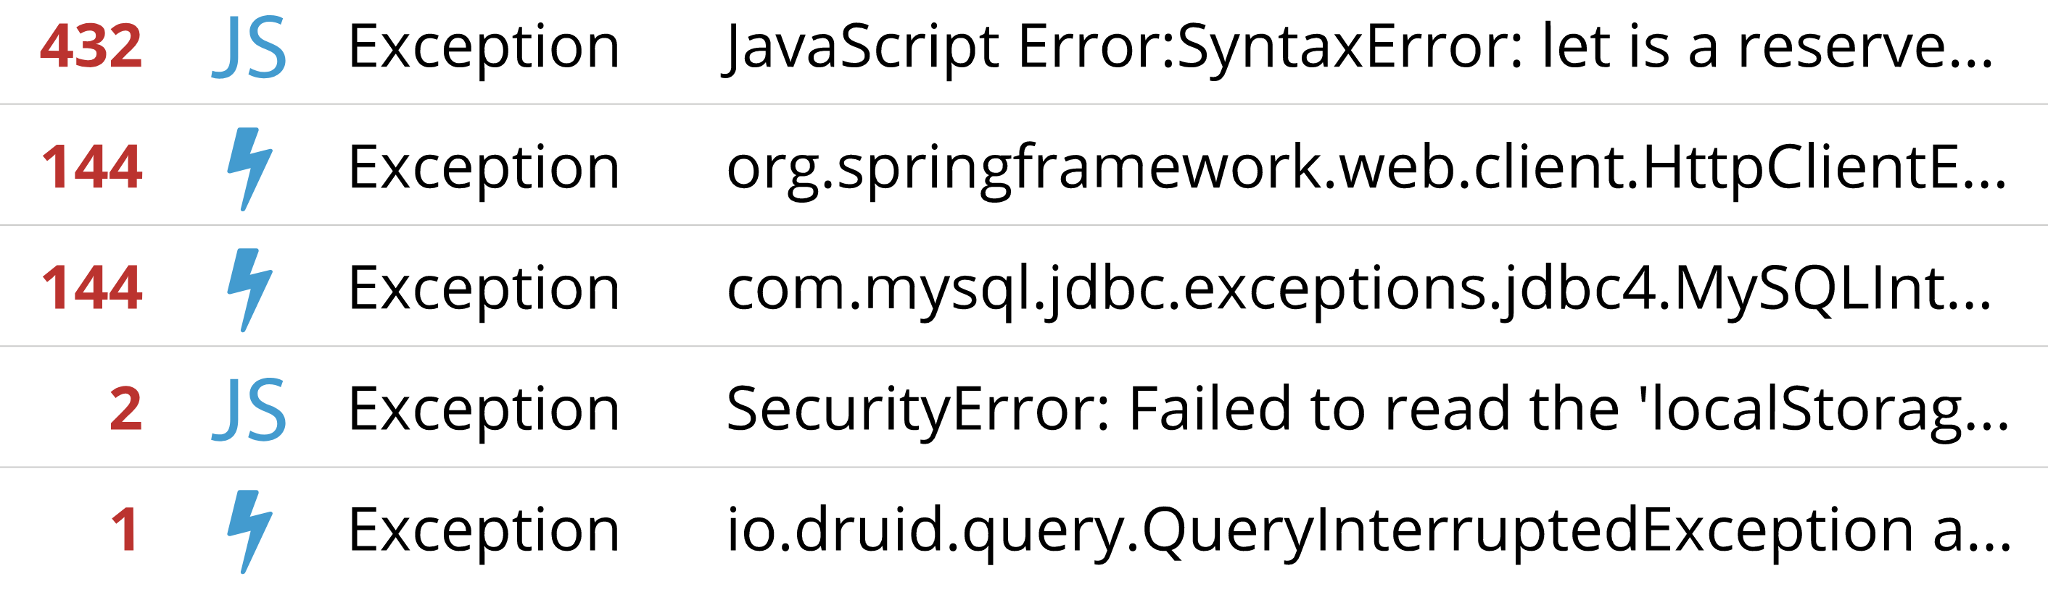
Example #4: becoming proactive
+

Slide 75
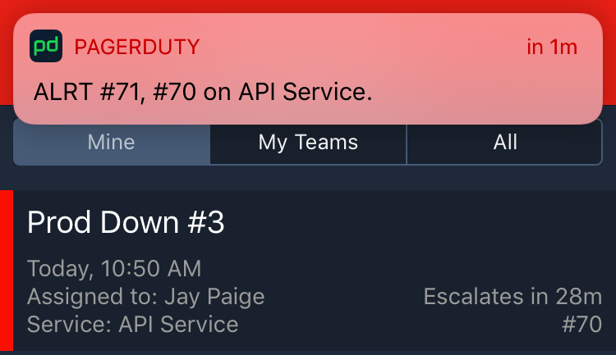
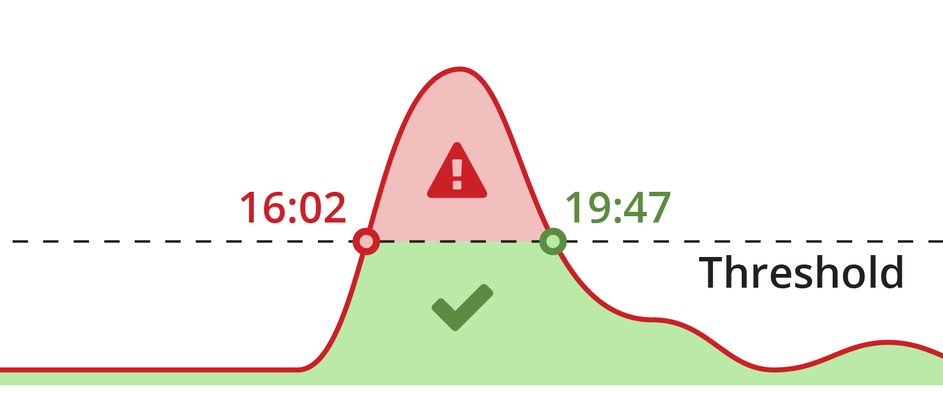
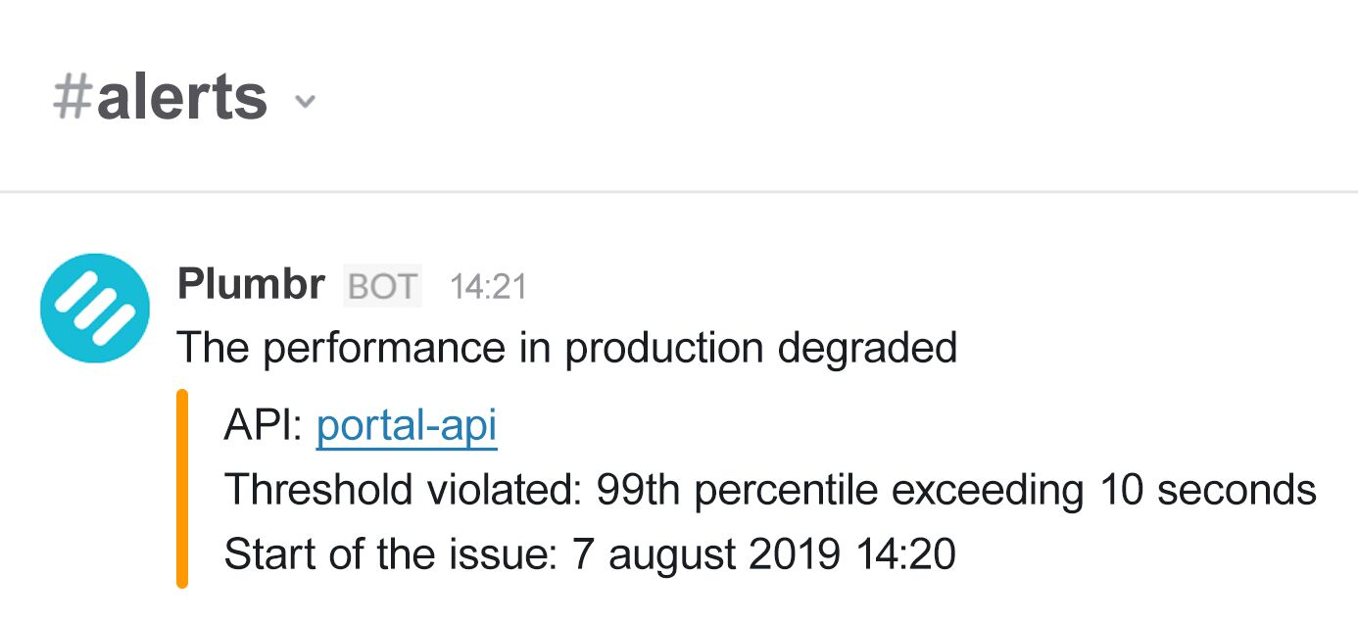
Example #4: becoming proactive

Slide 76
THANK-YOU

